Slide 1
Voice Telecommunications Accessibility for Individuals with Hearing Loss
Linda Kozma-Spytek
Technology Access Program
Gallaudet University; Washington, DC
ETSI STQ#47
6-10 October 2014
Prague, Czech republic

Slide 2
Technology Access Program (TAP)
Christian Vogler, Director
TAP has been partnering with:
  the Trace Center at University of Wisconsin-Madison; Gregg Vanderheiden
  Omnitor in Sweden; Gunnar Hellström
on:
  The Rehabilitation Engineering Research Center on Telecommunications Access (RERC-TA), funded by the National Institute on Disability and Rehabilitation Research (NIDRR), for the past 15 years

Slide 3
Research Goal
To better understand the technical parameters that lead to effective audio-only and audio/visual telecommunications by individuals with hearing loss

Slide 4
Voice Telecommunications Accessibility Experiments
five with-in subjects experiments, of approximately 120 subjects with hearing loss, have been completed
all examine the impact of a variety of technical parameters on voice telecommunications for individuals with hearing loss
both simulated and actual wireless device use
replication conditions from previous experiments as well as new conditions are included
receive-only testing

Slide 5
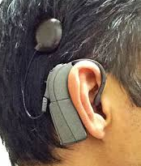
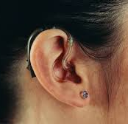
Participants were…
18 years of age or older
fluent in English
daily hearing aid or cochlear implant users
regular users of the voice telephone (rather than TTY, Video Relay Services or Text-Based IP Relay)
Depending on the test conditions for a given experiment, subjects may have also had to pass a vision or hearing screening.

Slide 6
We have investigated the effects of…
presentation mode
  audio only and the addition of a video channel
video quality
  video frame rate: 30 fps, 15 fps, 7.5 fps
  audio-video synchrony: -100ms, 0 ms, +100 ms and +200 ms audio re video)
audio quality
  codec audio bandwidth: NB (G.711, AMR-NB) and WB (AMR-WB)
  data rate: AMR-NB @ 5.9kbps & 12.2kbps; AMR-WB @ 12.65kbps & 23.85kbps
environment
  quiet and the addition of noise (10 dB SNR)

Slide 7
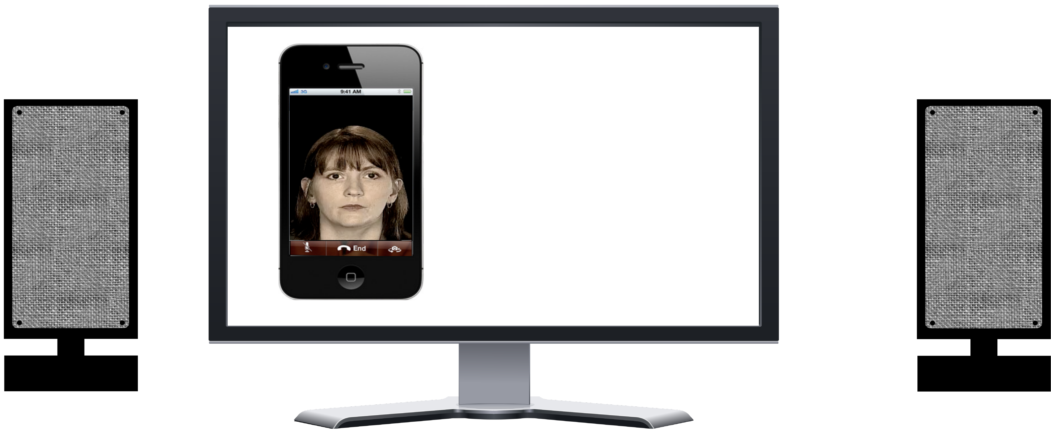
Apparatus
simulated telephony application
actual wireless device

Slide 8
Dependent Measures
Speech intelligibility (experiments 1-5)
  % words correct for sentence material
Sound quality (experiment 5)
  MOS – Mean Opinion Score
Subjective mental effort (experiments 1-4)
  SMEQ – Subjective Mental Effort Question
Purchase intent (experiments 1-5)
  yes/no response
Response time (experiment 4)
  end of stimulus to beginning of response in seconds

Slide 9
Speech Intelligibility – CASPER sentences
  72 Sets: 12 sentences per set; 1 female & 1 male speaker; AV
  -e.g.,
Take the steaks out of the freezer and put them on the counter.
Remember to take your sister to the airport tomorrow.
I quit my job.
I have a sweater that would look great with this plaid skirt.
Did you go to see the bird exhibit when you went to the zoo?
Where did you buy all that new furniture for the house?
Put all the golf clubs in the cart.
Don't be afraid of the thunder.
I really don't like to get injections.
The flowers bloomed
Do you think we should buy him a savings bond?
Have you heard her sing?

Slide 10
  MOS – Mean Opinion Score
In this experiment, we are evaluating systems that might be used for voice telecommunications services. You are going to hear a number of recorded sentences. We would like you to rate how good they sound. You will use the following scale to provide your opinion of their overall quality.
The overall quality of the speech was:
Excellent
Good
Fair
Poor
Bad

Slide 11
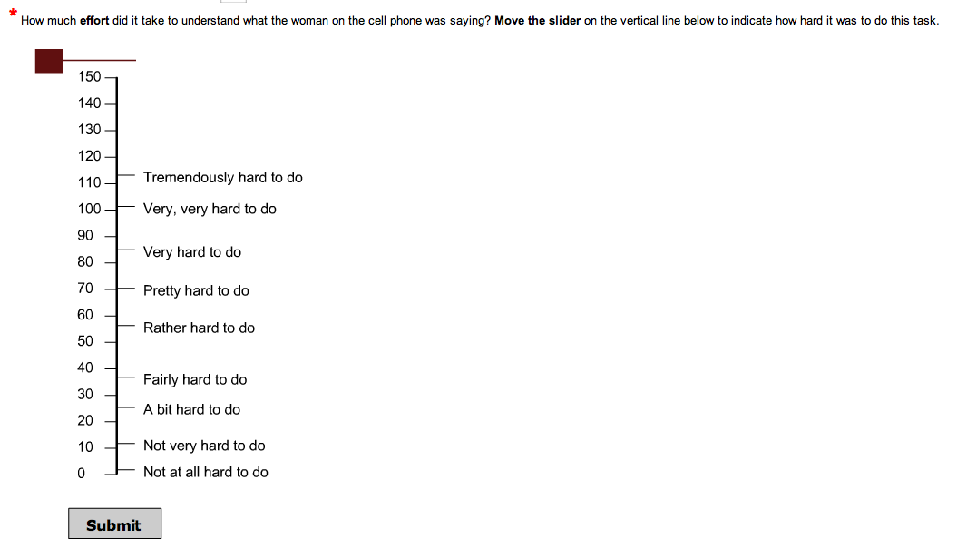
  SMEQ – Subjective Mental Effort Question
How much effort did it take to understand what the woman on the cell phone was saying?

Slide 12
Purchase Intent
Would you purchase (and use) a cell phone with this level of quality in order to both hear and lipread your calling partner?
Yes No

Slide 13
Presentation Mode and
Video Quality
Experiments 1 & 2

Slide 14
Test Methods
24 HA/CI users listened at 70 dB SPL
  via simulated wireless device use
  to one set of 12 sentences per condition (stimulus validation)
Conditions included
  audio-only with AMR-NB @ 12.2 kbps
  audio-video with AMR-NB @ 12.2 kbps and QCIF resolution (176x144)
    2 frame rates: 15 fps & 7.5 fps
    3 levels of audio-video synchrony: -100 ms, 0 ms & +100 ms (A re V)
Listeners
  repeated each sentence to evaluate speech understanding
  rated mental effort using the SMEQ
  indicated their likelihood to purchase and use a phone given the rated speech quality

Slide 15
Speech Understanding
*
*
% words understood (n=24)
*
*
*
*
*
*
Baseline
Audio-only
70%
15 15 15 7.5 7.5 7.5
fps
A re V
-100 ms 0 ms +100 ms -100 ms 0 ms +100 ms

Slide 16
Test Methods
22 HA/CI users listened at 70 dB SPL
  via simulated wireless device use
  to one set of 12 sentences per condition
Conditions included
  audio-only with AMR-NB @ 12.2 kbps
  audio-video with AMR-NB @ 12.2 kbps and near-CIF resolution (306x204)
    2 frame rates: 30 fps & 15 fps
    3 levels of audio-video synchrony: -100 ms, 0 ms & +100 ms (A re V)
Listeners
  repeated each sentence to evaluate speech understanding
  rated mental effort using the SMEQ
  indicated their likelihood to purchase and use a phone given the rated speech quality

Slide 17
Speech Understanding
% words understood (n=22)
*
*
*
*
*
*
Baseline
Audio-only
68%
15 15 30 30 30
fps
A re V
-100 ms +100 ms -100 ms 0 ms +100 ms

Slide 18
Environment
Experiment 3

Slide 19
Test Method
20 CI users listened at 65 dB SPL
  via simulated wireless device use
  to one set of 12 sentences per condition
Conditions included
  2 audio codecs (AMR-NB @ 12.2 kbps and AMR-WB @ 23.85)
  2 presentation modes ( A-only and Audio-Visual)
  2 environmental conditions (quiet and 10 dB SNR)
Listeners
  repeated each sentence to evaluate speech understanding
  rated mental effort using the SMEQ scale

Slide 20


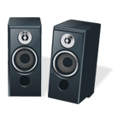
Noise
Noise
30°
30°
Subject

Slide 21
Speech Understanding

Slide 22
Mental Effort

Slide 23
Presentation Mode,
Video Quality and
Audio Quality
Experiment 4

Slide 24
Test Methods
20 CI users listened at their MCL
  over an iPhone 4s
  at the ear using their hearing devices’ microphone
  to one set of 12 sentences per condition
Conditions included
  audio-only with AMR-NB @ 12.2 kbps and AMR-WB @ 23.65 kbps
  audio-video with AMR-NB @ 12.2 kbps and near-CIF resolution (306x204); at 15 fps
    4 levels of audio-video synchrony: -100 ms, 0 ms, +100 ms, & +200 ms (A re V)
Listeners
  repeated each sentence to evaluate speech understanding
  rated mental effort using the SMEQ
  indicated their likelihood to purchase and use a phone given the rated speech quality

Slide 25
Speech Understanding
*
*
1.87 secs.
2.52 secs.

Slide 26
Audio Quality
Experiment 5

Slide 27
Test Method
36 HA/CI users listened at their MCL
  over an iPhone 5s
  at the ear using their hearing devices’ microphone
  to one set of 12 sentences per condition
Conditions included
  3 narrowband audio codecs (G.711, AMR-NB @ 5.95 & 12.2 kbps)
  3 wideband audio codecs (AMR-WB @ 12.65, 23.85 and 23.85 kbps low-pass filtered at 4 kHz)
Listeners
  repeated each sentence to evaluate speech understanding
  rated speech quality using the MOS scale
  indicated their likelihood to purchase and use a phone given the rated speech quality

Slide 28
Speech Understanding

Slide 29
Speech Quality
*

Slide 30
Purchase and Use

Slide 31
Primary Findings
The addition of video can significantly enhance speech understanding in telephony applications for individuals with hearing loss
Frame rate and small differences in audio-video synchrony can have large effects on speech understanding for videotelephony
  Frame rate: 15 fps
  AV synchrony: 0 ms – +100 ms audio re video
Video accessibility can be compromised by the unpredictable ways hardware and software alter the synchrony of the audio and video streams

Slide 32
Primary Findings
Wideband audio codecs (AMR-WB @ 12.65 & 23.85 kbps) were significantly better than narrowband audio codecs (G.711, AMR-NB @ 5.95 & 12.2 kbps) in terms of speech understanding (response time), mental effort, speech quality and likelihood to purchase and use for individuals with hearing loss who have higher frequency access
Noise (in the users environment) can significantly degrade the benefit of additional audio bandwidth and can also degrade the benefit of the addition of a video channel

Slide 33
Next Steps
Future research directions
  Network impairments
    type, level and modeling
  Conversational evaluations
    Do these findings translate into real world improvements in telecommunications accessibility?
  Multi-media access
    addition of text

Slide 34
Acknowledgements
The contents of this paper were developed with funding from:
the National Institute on Disability and Rehabilitation Research, U.S. Department of Education, grant numbers H133E090001 and H133E04001 - RERC on Telecommunications Access (However, those contents do not necessarily represent the policy of the Department of Education, and you should not assume endorsement by the Federal Government.)
a grant by the Verizon Foundation

